Slide 1
DeadlineDealer
Final Presentation
Bharathi Subramanian
Namit Arjaria
Shruti Bansal
Tejaswi M

Slide 2
Problem Statement
People struggle to get tasks, whether simple or complex, done on time, either because of an overload of work, or just because of procrastination.
Either way, it results in missed deadlines, incomplete tasks, and overall stress.

Slide 3
Proposal
A gamified To-Do list, where:
Users can group their tasks for easier reference
Users can set deadlines for themselves
Users get points for completing tasks on time
Users lose points for not completing tasks on time

Slide 4
Tech Stack
Languages:
JavaScript
Frameworks:
ReactJS
Backend:
Supabase
Other Tools:
CSS
Vite
Replit
Jira - https://tm988.atlassian.net/jira/software/projects/DEADLINE/list

Slide 5
DIAGRAMS

Slide 6
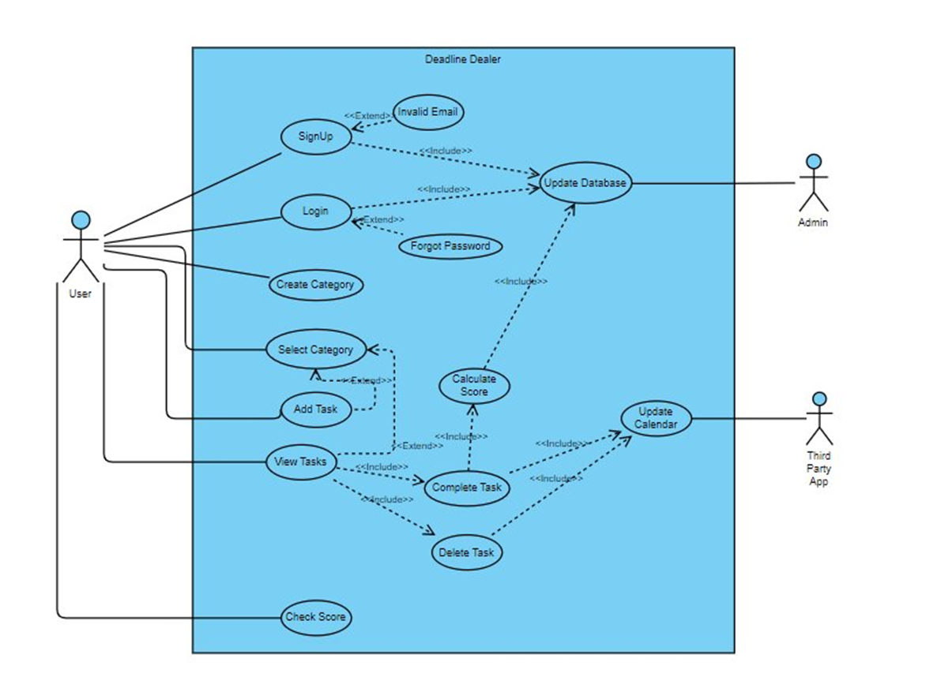
Use Case Diagram

Slide 7
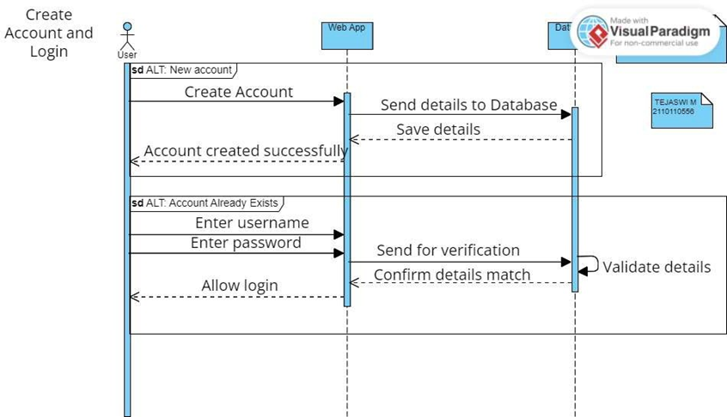
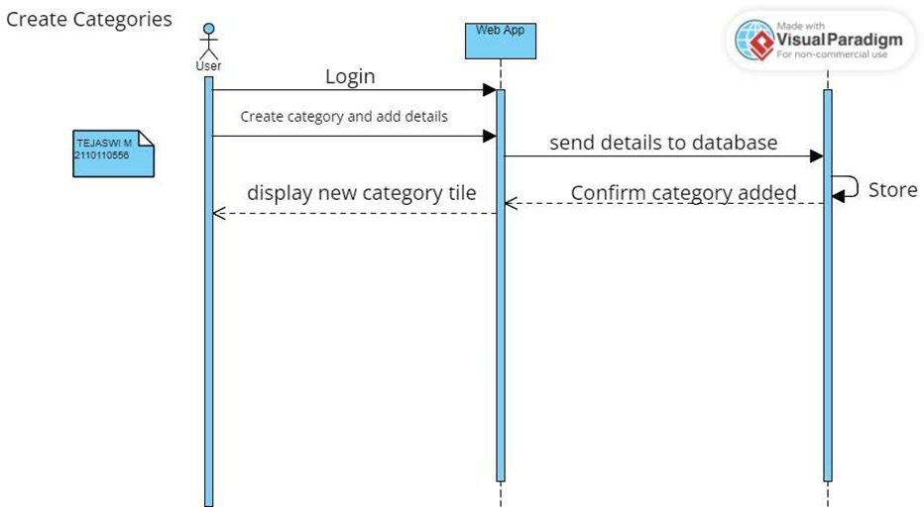
Sequence Diagrams

Slide 8
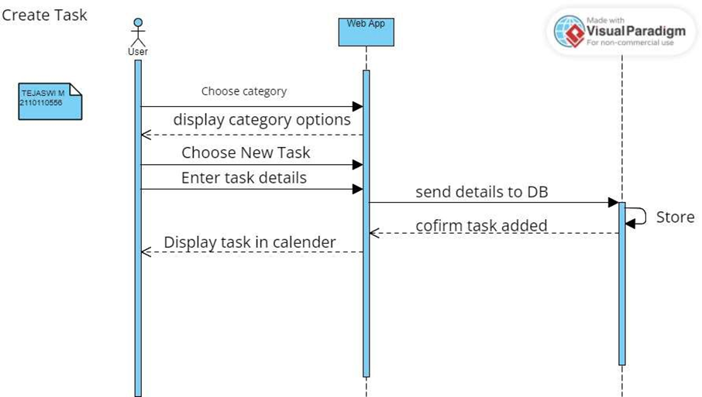
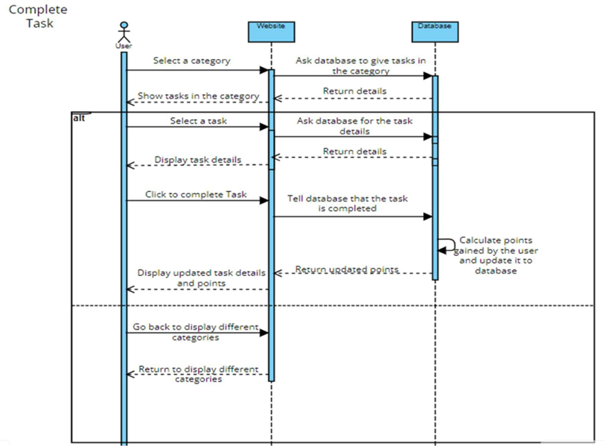
Sequence Diagrams

Slide 9
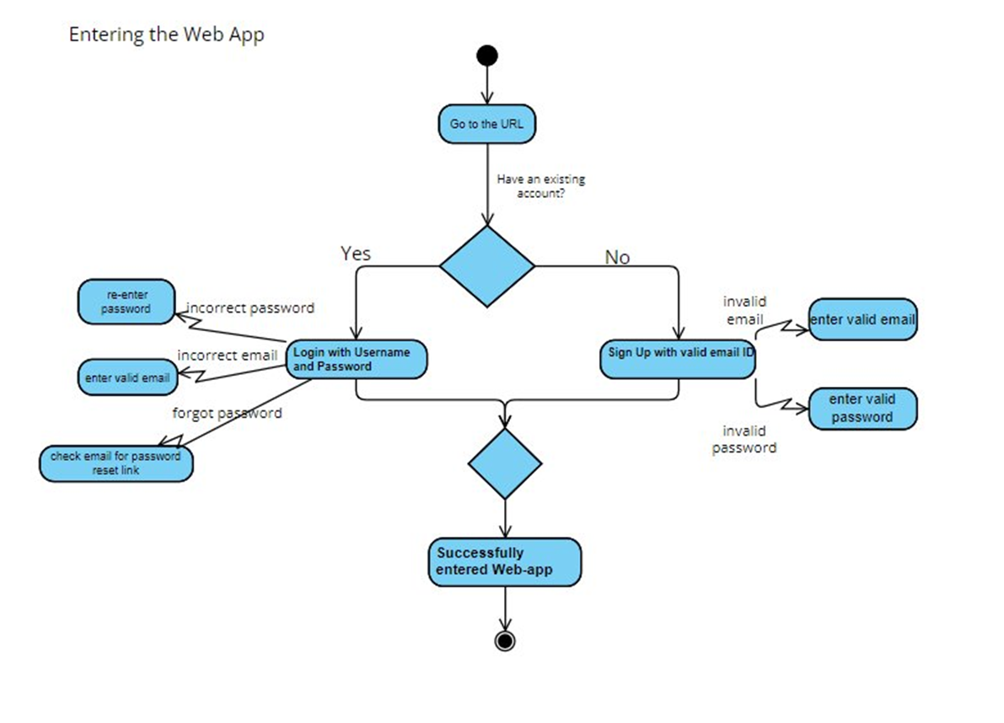
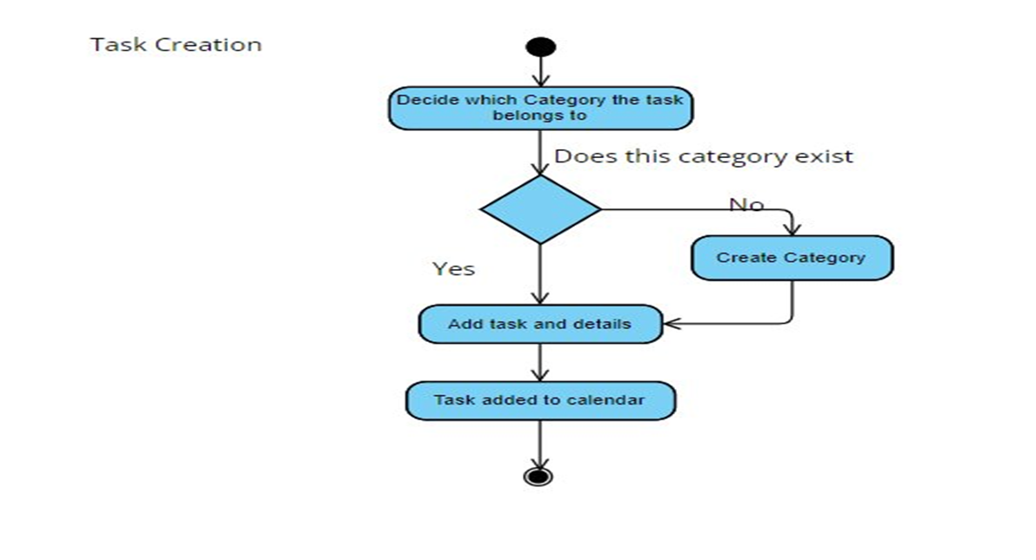
Activity Diagrams

Slide 10
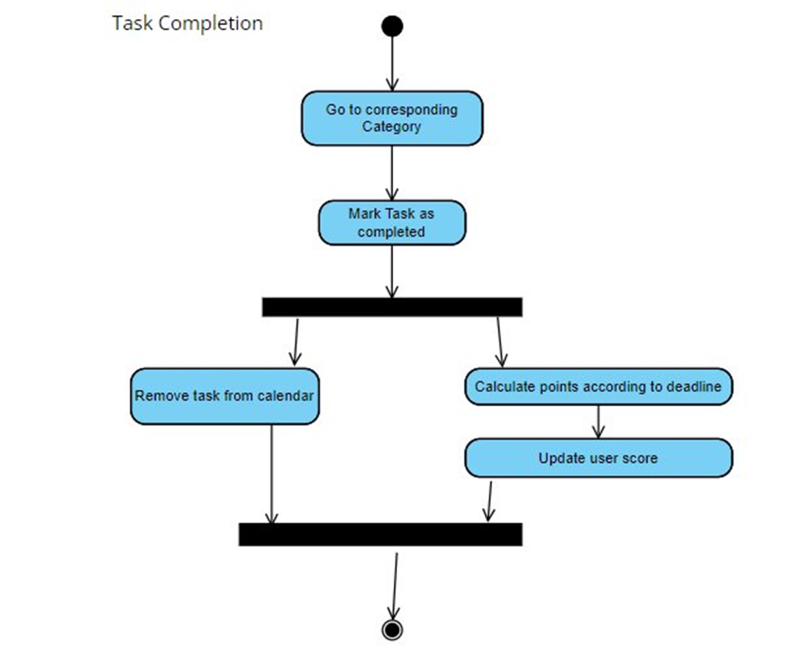
Activity Diagrams

Slide 11
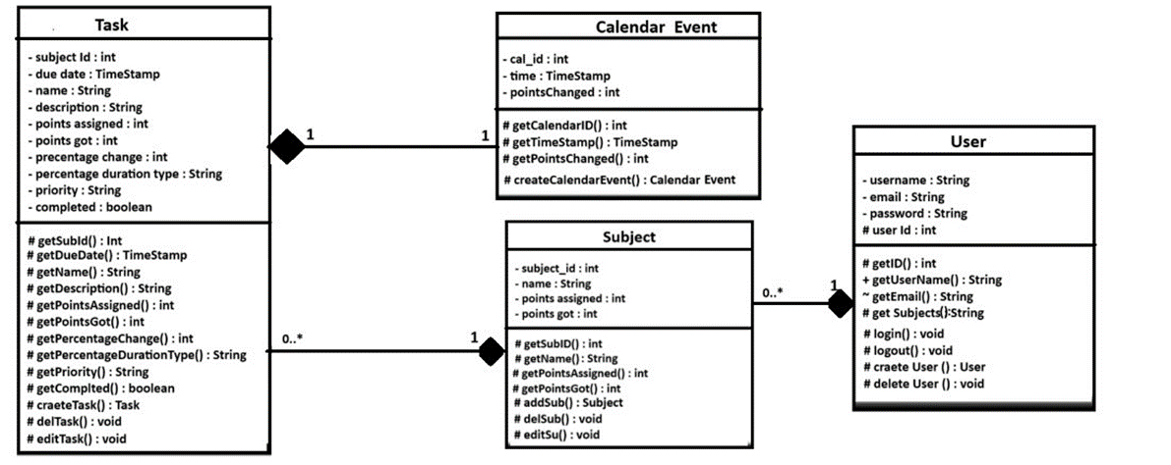
Class Diagram

Slide 12
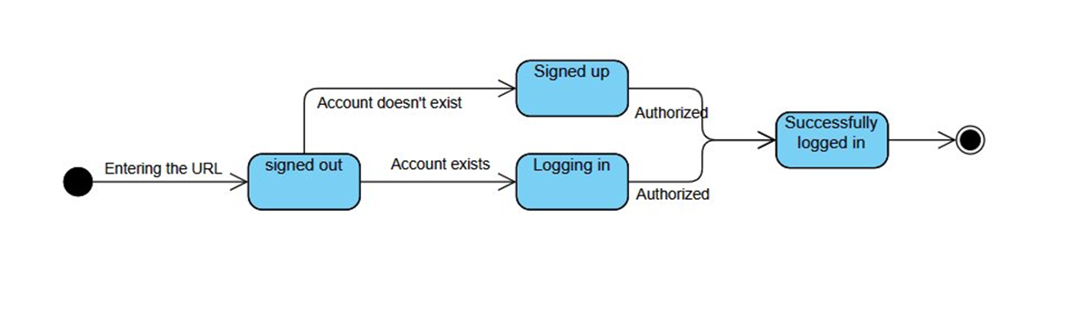
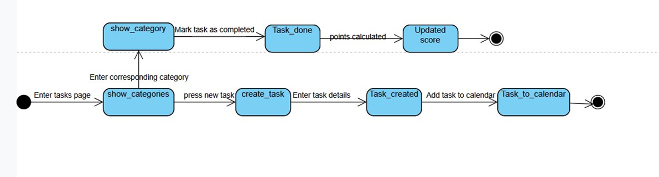
State Diagrams

Slide 13
DEMONSTRATION

Slide 14
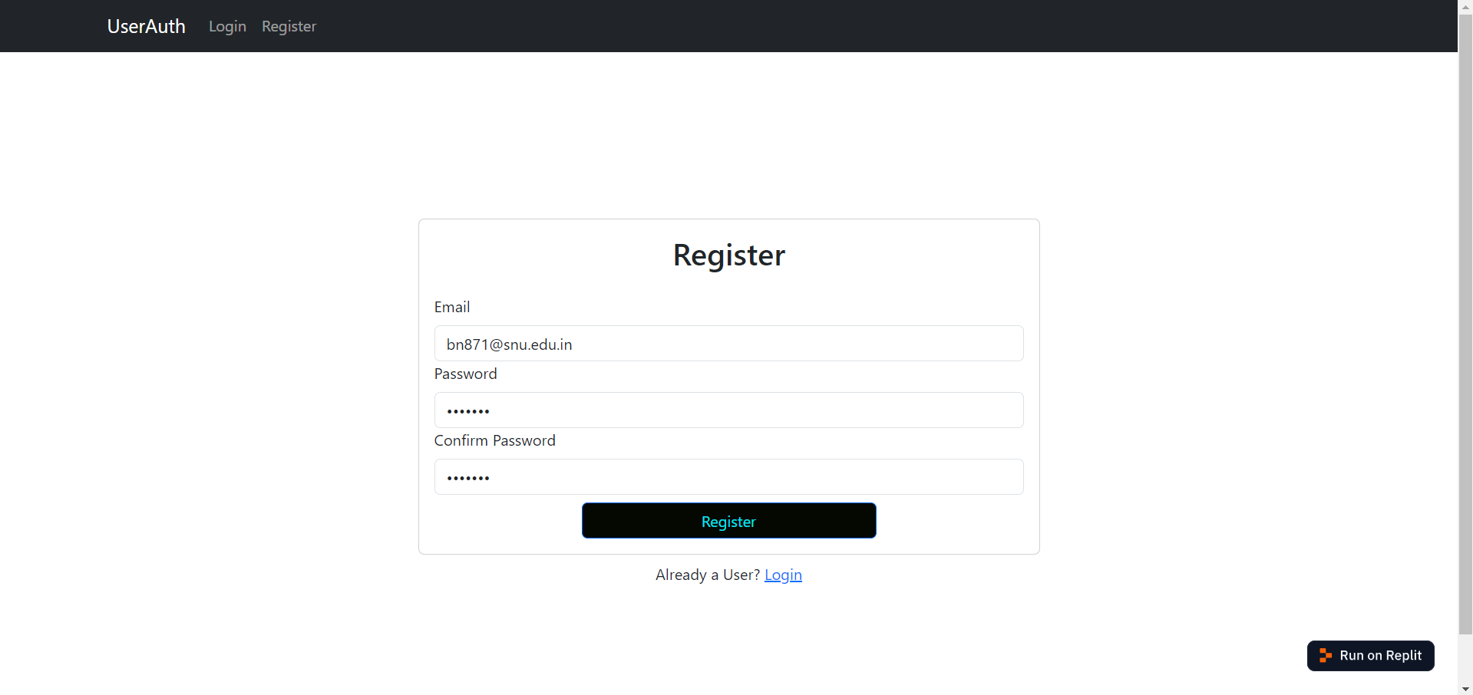
SignUp Screen

Slide 15
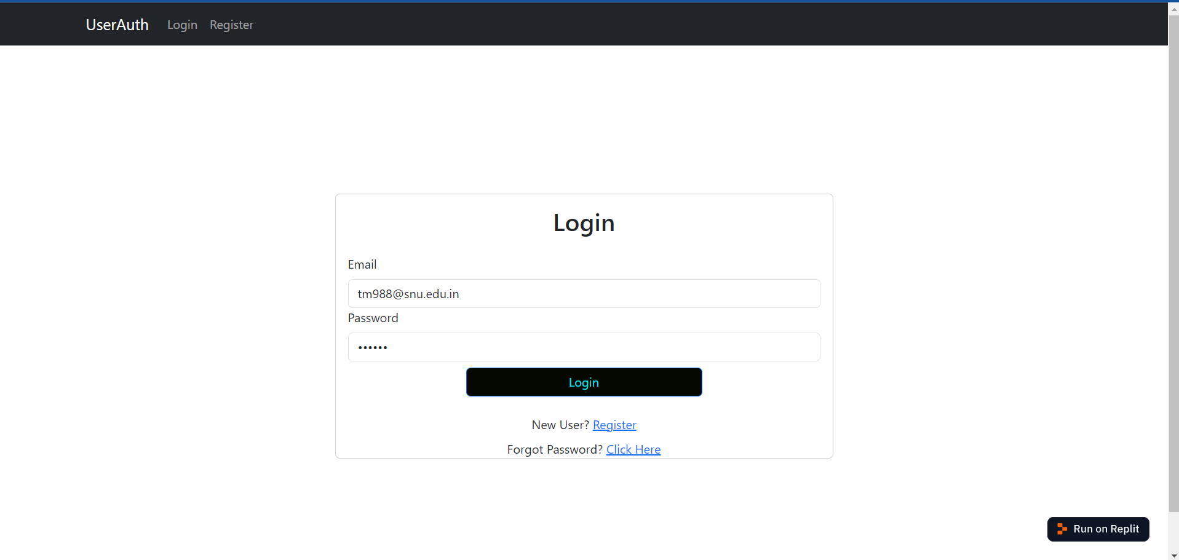
Login Screen

Slide 16
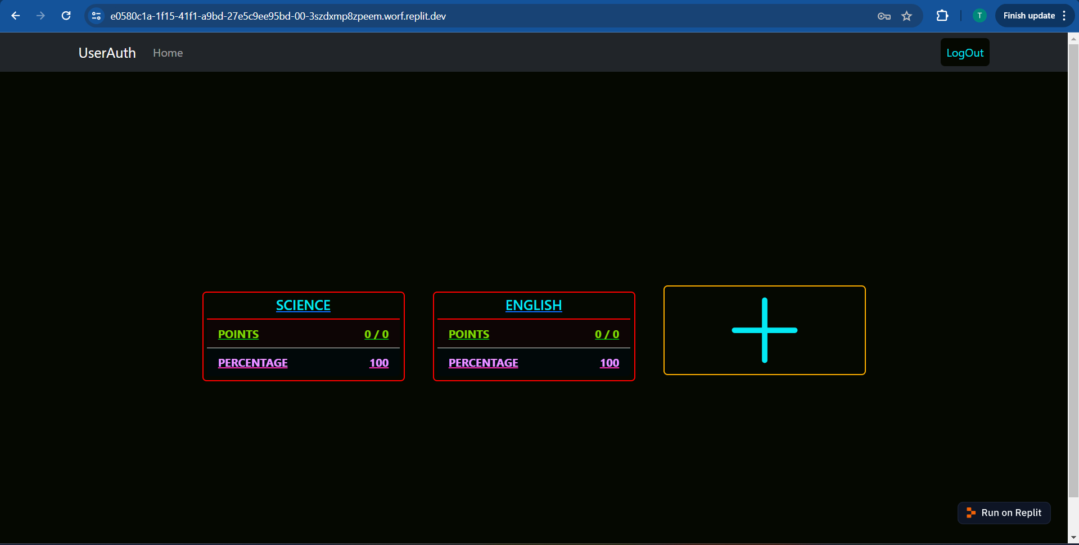
Home Page

Slide 17
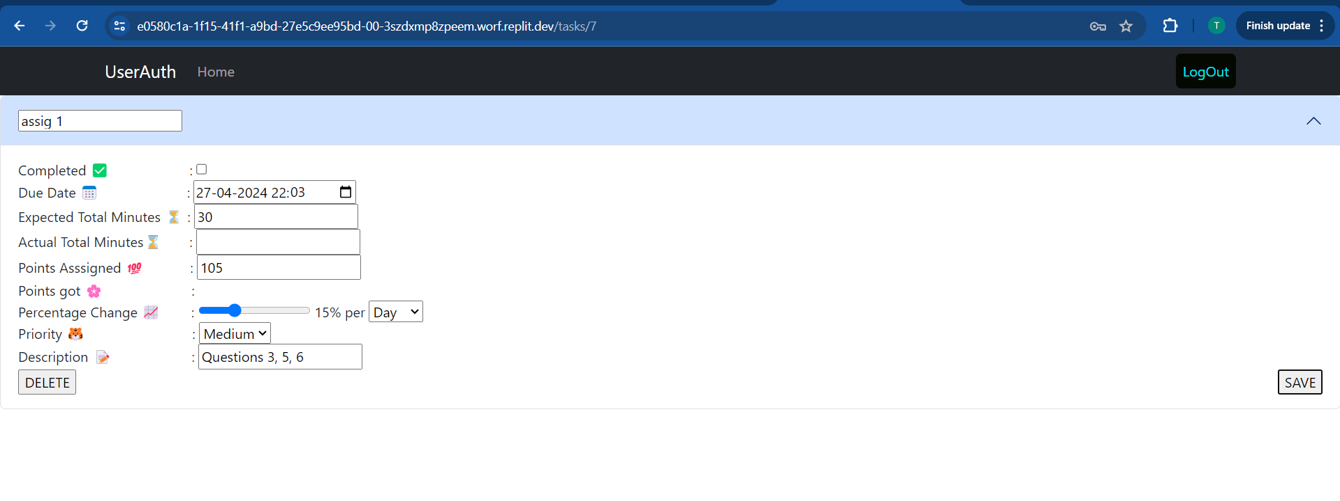
Tasks Screen

Slide 18
THANK YOU

